Slide 1
7.7 Finding the plane through three points

Slide 2
Introduction
In this topic, we will
Describe how to find a vector representation of a plane passing through three non-collinear points
Discuss issues related to the three points being essentially collinear

Slide 3
A plane through three points
In R³, three points may be collinear or not
If they are collinear, they define a line in 3-space
If they are not collinear, they define a plane

Slide 4
A plane through three points
Suppose we have three non-collinear vectors u₁, u₂ and u₃
Define

Slide 5
A plane through three points
All three of these vectors are parallel to the plane
Choose two vectors that have an angle between them closest to 90° and relabel them v₁ and v₂

Slide 6
A plane through three points
Given the vectors v₁ and v₂, apply Gram-Schmidt resulting in two orthonormal vectors parallel to the plane: and

Slide 7
A plane through three points
All three vectors u₁, u₂ and u₃ are in the plane, so choose that vector that has the smallest 2-norm
Relabel this vector u
Make u perpendicular to the plane

Slide 8
A plane through three points
Thus, a vector representation of the plane is
We can use to find an equation of the plane

Slide 9
Almost collinear
Suppose we have three points that are not collinear, but that are very close to being collinear
For example, would suggest two points are very close to each other
Issue: v₁ and v₂ may be almost parallel
We could calculate the cross product of these two vectors, and if
In either case, this will result in a high likelihood of any error being magnified, so it would be appropriate to declare the points essentially collinear and try to find a different point in the plane

Slide 10
Summary
Following this topic, you now
Know how to find a plane passing through three points
Understand that while three points may not be exactly collinear, they may be very close to being collinear

Slide 11
References
[1] https://en.wikipedia.org/wiki/Plane_(geometry)

Slide 12
Acknowledgments
None so far.

Slide 13
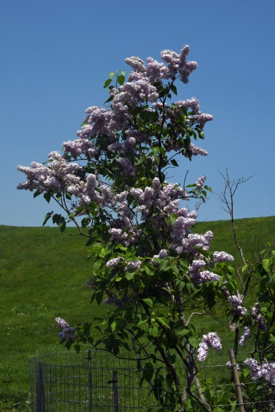
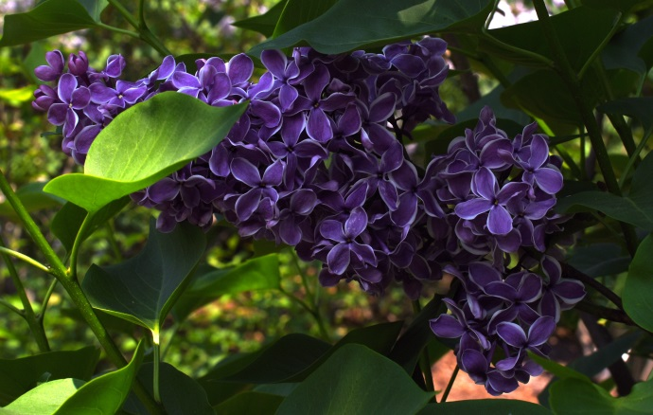
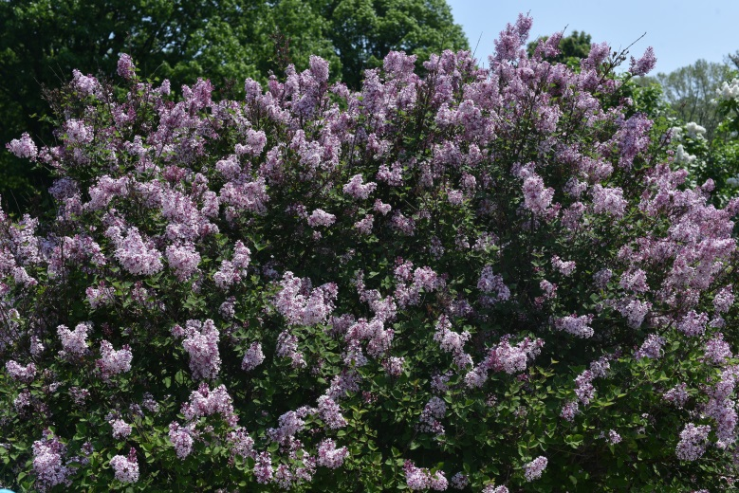
Colophon
These slides were prepared using the Cambria typeface. Mathematical equations use Times New Roman, and source code is presented using Consolas. Mathematical equations are prepared in MathType by Design Science, Inc.
Examples may be formulated and checked using Maple by Maplesoft, Inc.
The photographs of flowers and a monarch butter appearing on the title slide and accenting the top of each other slide were taken at the Royal Botanical Gardens in October of 2017 by Douglas Wilhelm Harder. Please see
https://www.rbg.ca/
for more information.

Slide 14
Disclaimer
These slides are provided for the ne 112 Linear algebra for nanotechnology engineering course taught at the University of Waterloo. The material in it reflects the authors’ best judgment in light of the information available to them at the time of preparation. Any reliance on these course slides by any party for any other purpose are the responsibility of such parties. The authors accept no responsibility for damages, if any, suffered by any party as a result of decisions made or actions based on these course slides for any other purpose than that for which it was intended.

